Slide 1


Advisor : Hoon Sung Chwa
Weekly Meeting
2023.03.13
Dept of Information & Communication Engineering, DGIST
Real-Time Computing Lab
Kang Young Eun ( kye0520 @dgist.ac.kr)

Slide 2
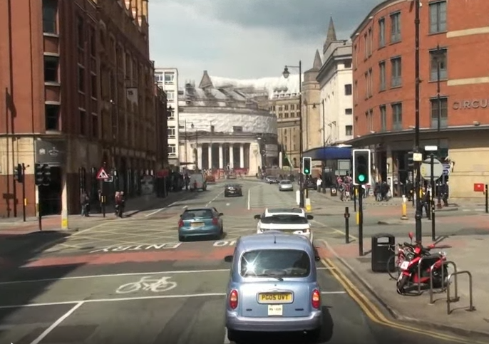
Image patching
According to the observation, calculating only important instances(RoIs) will help lower computation.
Original Input Image
RoI Extraction
RoI Patched Image
Q1. How to extract Region of Interest? Yolo localization
Q2. How does Image Patching impact detection accuracy?
2
Notes:
지난 번 1번 질문인 roi 추출 방식에 이어
Patching이 정확도에 끼치는 영향을 실험했다.

Slide 3
Content
Localization Accuracy of patching
Image Patching Accuracy
Experiment 1. Same execution time
Experiment 2. No Limit of Execution time
3
Notes:
2가지로 localization 정확도와 patchin의 정확도로 나누어 실험을 했는데
먼저 localization이 그대로 잘 되는지 실험

Slide 4
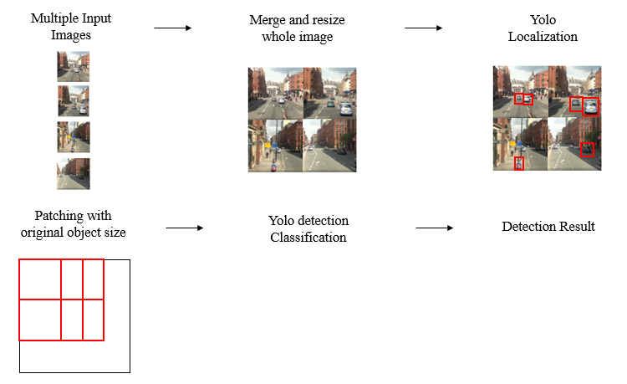
Localization Accuracy
Localization Accuracy
Does merging degrade localization accuracy?
Does patching maintain localization accuracy?
Each compared with ground truth.
640
1280
Patched object in 640, 1920 size
4
Notes:
2가지를 merge했어도 localization이 유지 되는가

Slide 5

Localization Accuracy
Localization Accuracy Results
Merging images slightly enhance localization accuracy
Patching decreases localization accuracy.
5
Notes:
일치하면 잘 된것
더 높으면 오히려 정확도를 더 높일 수 있게 되는 방법이라는 것.

Slide 6
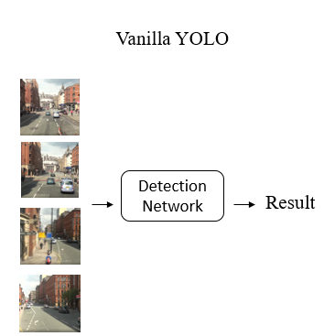
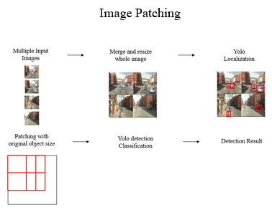
Accuracy of Patching
Accuracy results of patching
Accuracy results comparison with same execution time
Experiment Setup
 | mAP Results (ms)
Vanilla | 65.86
Patching | 61.1
Image width =1792
Image width = 960
Object size= 960
Execution time : 99ms
With the same execution time, patching shows 4.76 of mAP loss.
6
Notes:
먼저 시간을 동일하게 셋팅하고 정확도를 측정.
4.76의 정확도 손실이 있었다.
그렇다면 시간에 제한을 두지 않았을 경우에는 어떤지.

Slide 7
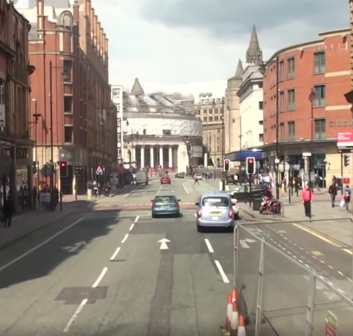
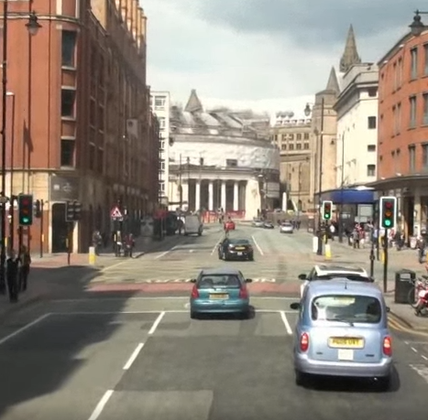
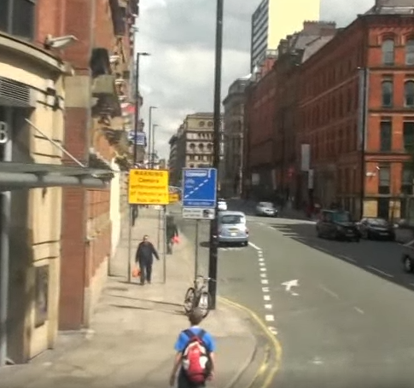
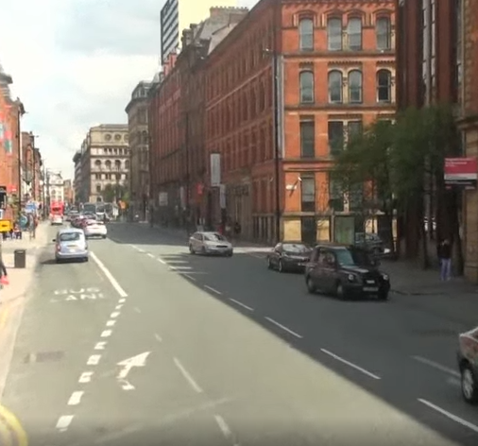
Accuracy of Patching
Experiment Setup
Accuracy with no limit of execution time
Vanilla YOLO
Image Patching
Detection
Network
Result
Image width = 1280
all objects in original image size of 1920, 640
Patch frame size fits all objects
Image width = 640
7
Notes:
실행 시간에 제한을 두지 않고 patching의 정확도 측정
Vanilla yolo는

Slide 8
Accuracy of Patching
Accuracy results of patching
Patching object with 640 size shows 5 accuracy loss.
Patching with 1920 (original object size) shows dynamically selecting object size will help increase patching accuracy.
8
Notes:
이번에는 vanilla 를 1280dml 정확도와 localization을 절반으로 줄인 640으로 localization을 진행하고
원본 사이즈로 patching을 해서 한 결과를 확인.
정확도는 6.07 밖에 차이가 나지 않는다. Patching을 원본 사이즈로 해서\
Localization을 해서 patching을 원본 사이즈로 했더니 정확도가 굉장히 작은 양 만큼 줄어들더라.
근데 canvas size를 조절 x고ㅓ

Slide 9
Summary
Localization Accuracy of patching
Image merging slightly increases localization accuracy.
Patching object as the same vanilla size decreases localization accuracy.
Image Patching Accuracy
Patching shows 4.76 of mAP loss with the same execution time
Dynamically patching objects may help increase patching accuracy.
To compensate accuracy loss of patching,
Object Packing Algorithm
Object Padding
Dynamic object size selection
9
9
9

Slide 10

Advisor : Hoon Sung Chwa
Thank you
Dept of Information & Communication Engineering, DGIST
Real-Time Computing Lab
Kang Young Eun (kye0520@dgist.ac.kr)

